Slide 1
IST687 – Applied Data Science
Chapter 17
Hi Ho, Hi Ho – Data Mining We Go

Slide 2
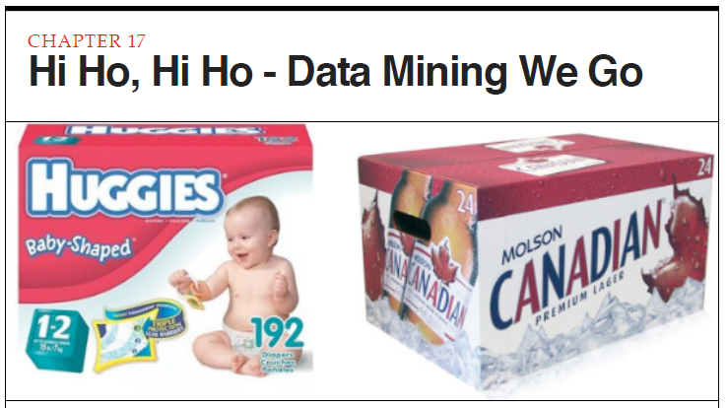
Data Science
Data Mining is an area of research and practice that is focused on discovering novel patterns in data. As usual, R has lots of possibilities for data mining. In this chapter we will begin experimentation with essential data mining techniques by trying out one of the easiest methods to understand: association rules mining. More beer and diapers please

Slide 3
Data Science
Chapter Objectives
Basic concepts of Data Mining
Use case illustration of “association rules mining”
Review and apply 4 Data Mining Processes
Data Preparation
Exploratory Data Analysis
Model Development
Interpretation of Results
Develop representative Data Mining “R” code

Slide 4
Data Science
Data Mining
Use of algorithms and computers to discover novel and interesting patterns within data
Diapers & Beer
Machine Learning

Slide 5
Data Science
Data Mining: 4 Processes
Data Preparation
Exploratory data analysis
Model development
Interpretation of results
Iterative process vs linear

Slide 6
Data Science
Data Mining: 4 Processes
Data Preparation
Most time consuming
Data organization
Data completeness
Data accuracy
Data Transformation
Exploratory data analysis
Model development
Interpretation of results

Slide 7
Data Science
Data Mining: 4 Processes
Data Preparation
Exploratory data analysis
Preliminary data context assessment
Visualization analysis
Key values for parameters
Model development
Interpretation of results

Slide 8
Data Science
Data Mining: 4 Processes
Data Preparation
Exploratory data analysis
Model development
Most complex/interesting
Test selection of data mining techniques
Chapter focus -> “association rules mining”
Interpretation of results

Slide 9
Data Science
Data Mining: 4 Processes
Data Preparation
Exploratory data analysis
Model development
Interpretation of results
Making sense of data mining output
Determine actionable conclusions

Slide 10
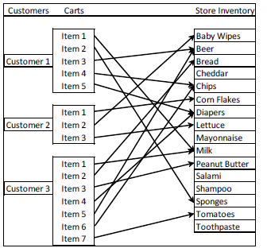
Data Science
Use Case: supermarket grocery cart

Slide 11
Data Science
Association rules algorithm/affinity analysis
Grocery cart(s) containing items from a larger set of stock items
Support Rule
The proportion of times that a particular paring occurs across all shopping carts
Confidence quantity
How frequently a particular pair occurs among all the items when the first item is present
Lift: Confidence / probability of second item
Support value: .067
Diapers and beer occurred in 2 out of 3 carts
Confidence value: 0.5
Beer occurred 50% of the time diapers was in the cart
Lift value: 2.5 (probability of beer in cart: 20%) [0.5/0.2]

Slide 12
Data Science
Data Mining Process 1: Data Preparation
install.packages("arules")
library("arules")
Groceries data set
Ready to be analyzed
Data Mining Process 2: Exploratory Data Analysis
data(Groceries)
summary(Groceries)

Slide 13
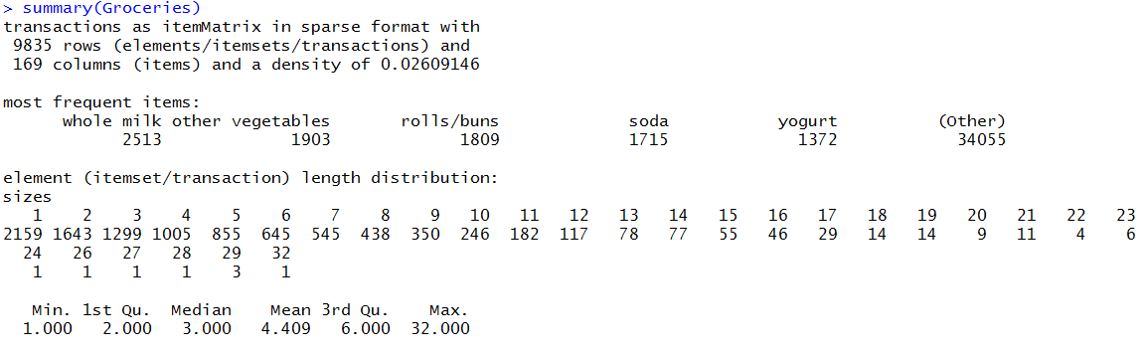
Data Science

Slide 14
Data Science
Process 2: Exploratory Data Analysis
Groceries data set –> context
itemMatrix, sparse format
9,835 rows, 169 columns
Row = basket/grocery cart
Column = grocery item/product
Item in grocery basket indication -> 1, 0
Items occurring most frequently
Notes:
Play with groceries in R

Slide 15
Data Science
Process 2: Exploratory Data Analysis
Groceries data set –> context
itemFrequencyPlot() function
Need to specify support parameter/argument

Slide 16
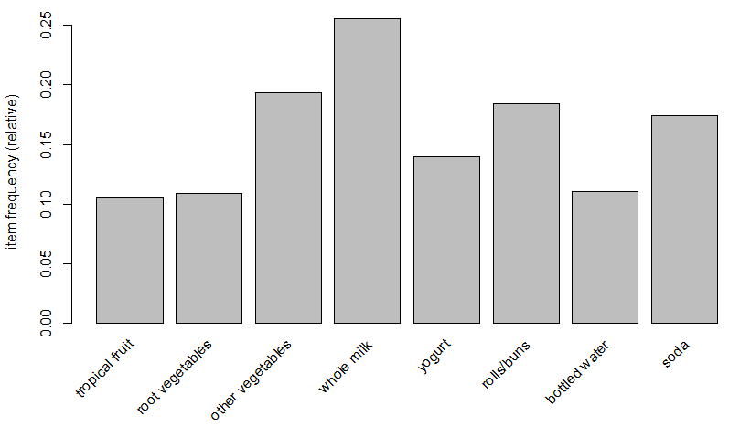
Data Science
itemFrequencyPlot(Groceries,support=0.1)

Slide 17
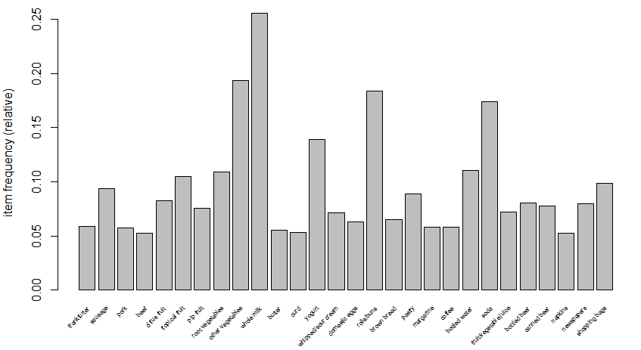
Data Science
itemFrequencyPlot(Groceries,support=0.05,cex.names=0.5)

Slide 18
Data Science
Data Mining Process 3: Model Development
Generate Rules
Values of Support
Focus on items with some meaningful frequency
apriori() command
Finding rules in transaction data
Rules format: Equation context: LHS (let hand side), RHS (right hand side)
Support for a rule (re-cap)
Frequency of co-occurrence of both members of the pair, i.e. LHS & RHS together
If milk and butter occur together in 10% of grocery carts
Confidence of a rule (re-cap)
Proportion of time that the LHS and RHS occur together vs. the total number of appearances of LHS
If milk by itself, (ignoring butter) occurs in 25% of the carts, them milk/butter confidence is .40,, (.10/.25)
Lift
Confidence divided by the probability of the RHS occuring
RHS/LHS
RHS: one item
LHS: multiple items

Slide 19
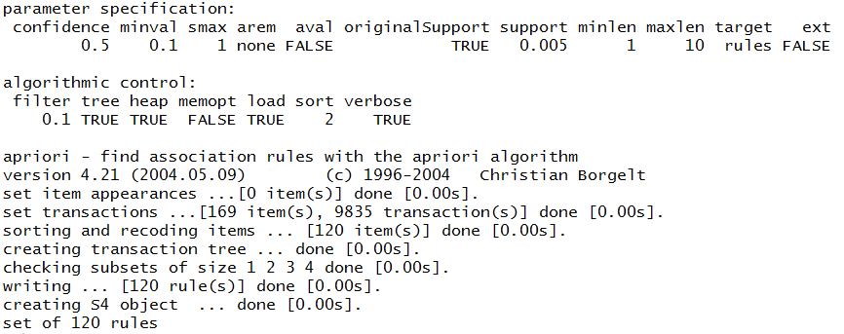
Data Science
apriori(Groceries,parameter=list(support=0.005,confidence=0.5))

Slide 20
Data Science
change support value
rerun apriori
store resulting rules
review output via summary function

Slide 21
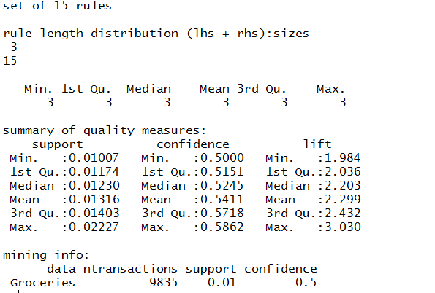
Data Science
ruleset <- apriori(Groceries, parameter=list(support=0.01,confidence=0.5))
summary(ruleset)

Slide 22
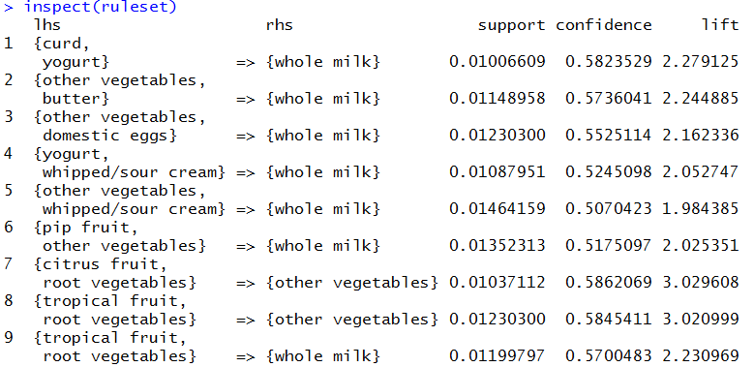
Data Science

Slide 23
Data Science
#
>install.packages("arulesViz")
>library(arulesViz)
#
>ruleset <- apriori(Groceries,parameter=list(support=0.005,confidence=0.35))
>plot(ruleset)
#

Slide 24
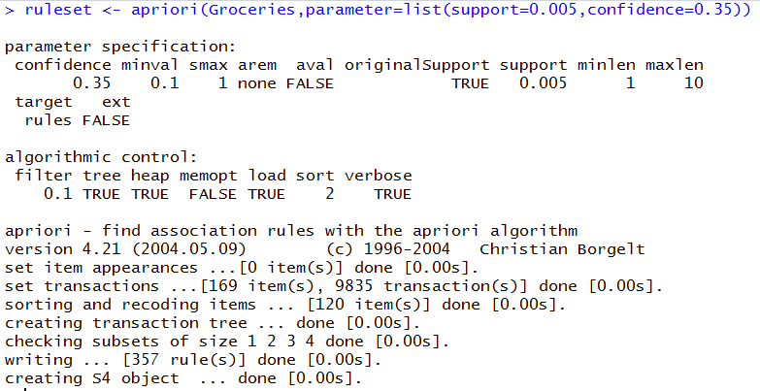
Data Science

Slide 25
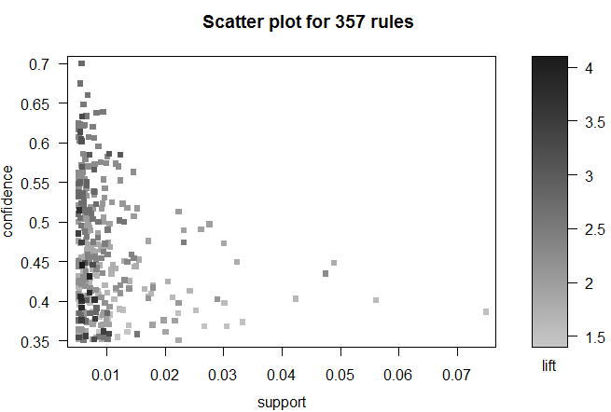
Data Science
plot(ruleset)

Slide 26
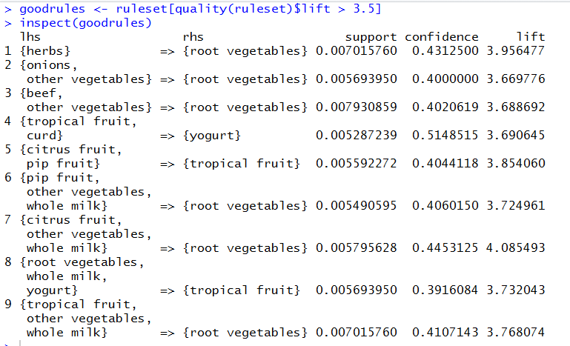
Data Science
Data Mining Process 4: Interpreting results

Slide 27
Data Science
Data Mining Process 4: Interpreting results
Shoppers purchasing in particular combinations that might be recipe oriented
Soup
Fruit platter with dip
Actionable recommendations to management might include:
Publish recipes along with coupons
Publish visuals of the finished product along with the appropriate marketing verbiage
Place recipes and visuals coincident with item/product locations

Slide 28
IST687 – Applied Data Science
End of Chapter 17 Lecture
Hi Ho, Hi Ho – Data Mining We Go

